Slide 1
CS 412 Intro. to Data Mining
Chapter 5. Data Cube Technology
Qi Li, Computer Science, Univ. Illinois at Urbana-Champaign, 2018

Slide 2
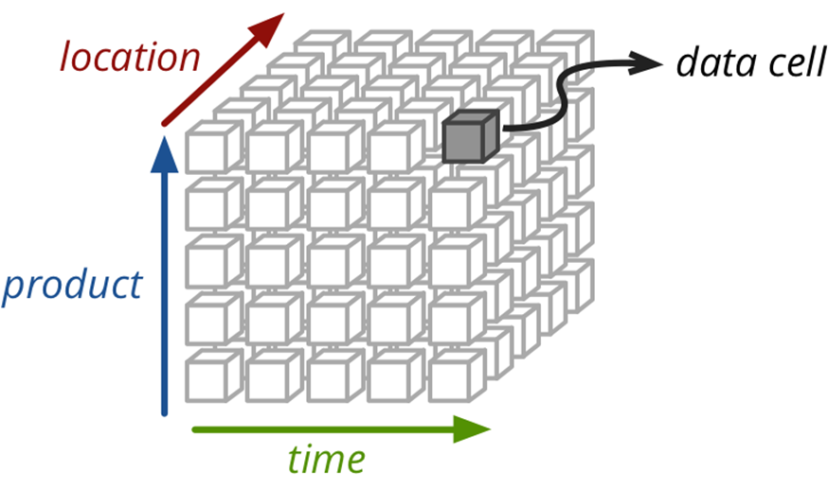
Chapter 5: Data Cube Technology
Data Cube Computation: Basic Concepts
Data Cube Computation Methods
Processing Advanced Queries with Data Cube Technology
Multidimensional Data Analysis in Cube Space
Summary
Notes:
2

Slide 3
Data Cube: A Lattice of Cuboids
all
0-D (apex) cuboid
time
item
location
supplier
1-D cuboids
time,location
item,location
location,supplier
2-D cuboids
time,item
time,supplier
item,supplier
time,location,supplier
3-D cuboids
time,item,location
time,item,supplier
item,location,supplier
4-D (base) cuboid
time, item, location, supplierc

Slide 4
Data Cube: A Lattice of Cuboids
all
Base vs. aggregate cells
Ancestor vs. descendant cells
Parent vs. child cells
(*,*,*,*)
(*, milk, *, *)
(*, milk, Urbana, *)
(*, milk, Chicago, *)
(9/15, milk, Urbana, *)
(9/15, milk, Urbana, Dairy_land)
time
item
location
supplier
time,item
0-D (agg)
time,location
item,location
location,supplier
time,supplier
item,supplier
1-D (agg)
2-D (agg)
time,item,location
time,location,supplier
time,item,supplier
item,location,supplier
2-D (agg)
3-D (agg)
time, item, location, supplier
4-D (base)
Notes:
Xinyang:
* More detailed examples
* Animations

Slide 5
Cube Materialization: Full Cube vs. Iceberg Cube
Full cube vs. iceberg cube
compute cube sales_iceberg as​
SELECT month, city, customer_group, COUNT(*)​
FROM salesInfo​
CUBE BY month, city, customer_group​
HAVING count(*) >= min support​
iceberg condition
Compute only the cells whose measure satisfies the iceberg condition
Only a small portion of cells may be “above the water’’ in a sparse cube
Ex.: Show only those cells whose count is no less than 100
Notes:
5
Xinyang:
Reformat iceberg cube query
Refined image
Animations
2*(2^{100}-1)-1, 1
Explanation: one cell, such as (a1, a2, …., a100) generates 2^100 -1 aggregate cells, because choose(100 1) + choose (100 2) + ... choose (100, 100) = 2^100 - 1 aggregate cells.
For two cell question, it generates 2 * (2^100-1) -1 distinct aggregate cells because (*, *, …, *) generated by (a1, a2, …., a100) and (b1, b2, …, b100) will be merged into one cell:
(*, *, …, *): 2. Hence we have 2*(2^{100}-1)-1

Slide 6
Why Iceberg Cube?
Advantages of computing iceberg cubes
No need to save nor show those cells whose value is below the threshold (iceberg condition)
Efficient methods may even avoid computing the un-needed, intermediate cells
Avoid explosive growth
Example: A cube with 100 dimensions
Suppose it contains only 2 base cells: {(a₁, a₂, a₃, …., a₁₀₀), (a₁, a₂, b₃, …, b₁₀₀)}
How many aggregate cells if “having count >= 1”?
Answer: (2¹⁰¹ ─ 2) ─ 4 (Why?!)
What about the iceberg cells, (i,e., with condition: “having count >= 2”)?
Answer: 4 (Why?!)
Notes:
Xinyang:
* Animations
For {(a₁, a₂, a₃ . . . , a₁₀₀), (a₁, a₂, b₃, . . . , b₁₀₀)}, the total # of non-base cells should be 2 * (2^{100} – 1) – 4.
This is calculated as follows:
(a1, a2, a3 . . . , a100) will generate 2^{100} - 1 non-base cells
(a1, a2, b3, . . . , b100) will generate 2^{100} - 1 non-base cells
Among these, 4 cells are overlapped and thus minus 4 so we get: 2*(2^{100} - 1) – 1 - 3 = 2*2^{100} - 6
These 4 cells are:
(a1, a2, *, ..., *): 2 in origin it should be: (a1, b2, *, …):1, (b1, a2, *…):1 , but now the first two dimensions of 2 base cells are same, so they can be merged.
(a1, *, *, ..., *): 2 in origin it should be: (a1, *, …):1, (b1, *, *, …):1
(*, a2, *, ..., *): 2
(*, *, *, ..., *): 2

Slide 7
Is Iceberg Cube Good Enough? Closed Cube & Cube Shell
Let cube P have only 2 base cells: {(a₁, a₂, a₃ . . . , a₁₀₀):10, (a₁, a₂, b₃, . . . , b₁₀₀):10}
How many cells will the iceberg cube contain if “having count(*) ≥ 10”?
Answer: 2¹⁰¹ ─ 4 (still too big!)
Close cube:
A cell c is closed if there exists no cell d, such that d is a descendant of c, and d has the same measure value as c 没有子女和他一样的计数。
Ex. The same cube P has only 3 closed cells:
{(a₁, a₂, *, …, *): 20, (a₁, a₂, a₃ . . . , a₁₀₀): 10, (a₁, a₂, b₃, . . . , b₁₀₀): 10}
A closed cube is a cube consisting of only closed cells
Cube Shell: The cuboids involving only a small # of dimensions, e.g., 2
Idea: Only compute cube shells, other dimension combinations can be computed on the fly
Q: For (A₁, A₂, … A₁₀₀), how many combinations to compute?
Notes:
Xinyang:
How many cells will the iceberg cube contain if “having count(*) ≥ 10”?
Only ask for cells, not distinct cells.
Therefore, each base cell can generate 2^100 cells. In total, there are 2 *(2^100) cells.
Then, we merge 4 overlap, 2 *(2^100) – 4

Slide 8
Chapter 5: Data Cube Technology
Data Cube Computation: Basic Concepts
Data Cube Computation Methods
Multidimensional Data Analysis in Cube Space
Summary
Notes:
8

Slide 9
Roadmap for Efficient Computation
General computation heuristics ^{[1]}
Computing full/iceberg cubes: 3 methodologies
Bottom-Up:
Multi-Way array aggregation ^{[2]}
Top-down:
BUC ^{[3]}
High-dimensional OLAP:
A Shell-Fragment Approach ^{[4]}
Computing alternative kinds of cubes:
Partial cube, closed cube, approximate cube, ……
(Agarwal et al.’96)
(Zhao, Deshpande & Naughton, SIGMOD’97)
(Beyer & Ramarkrishnan, SIGMOD’99)
(Li, et al. VLDB’04)
Notes:
Xinyang:
Delete the ‘roadmap’ image
Re-format references (Do we really need these references ?)
It seems we have removed the star-cubing algorithm afterwards, so I removed it from this page

Slide 10
Efficient Data Cube Computation: General Heuristics
Sorting, hashing, and grouping operations are applied to the dimension attributes in order to reorder and cluster related tuples
Share-sorts
Share-partitions
all
product
date
country
prod,date
prod,country
Aggregates may be computed from previously computed aggregates, rather than from the base fact table
Smallest-child: computing a cuboid from the smallest, previously computed cuboid
Cache-results: caching results of a cuboid from which other cuboids are computed to reduce disk I/Os
Amortize-scans: computing as many as possible cuboids at the same time to amortize disk reads
date, country
prod, date, country
S. Agarwal, R. Agrawal, P. M. Deshpande, A. Gupta, J. F. Naughton, R. Ramakrishnan, S. Sarawagi. On the computation of multidimensional aggregates. VLDB’96
Notes:
Xinyang:
Too many concepts?

Slide 11
Multi-Way Array Aggregation (MOLAP)
Full cube computation
Bottom-up
Array-based
Limited RAM -> Array chunking
Each time load one chunk into memory
How to compute aggregates efficiently?
Simultaneous aggregation on multiple dimensions
Re-use intermediate aggregate values
Notes:
Jiaxin: I think Apriori is an algorithm in frequent pattern mining? Maybe we'd better not introduce it at this early time.

Slide 12
Multi-Way Array Aggregation (MOLAP)
Partition arrays into chunks (a small subcube which fits in memory).
Compressed sparse array addressing: (chunk_id, offset)
Compute aggregates in “multiway” by visiting cube cells in the order which minimizes the # of times to visit each cell, and reduces memory access and storage cost
C
c3
61
62
63
64
c2
45
46
47
48
c1
29
30
31
32
What is the best traversing order to do multi-way aggregation?
c 0
B
60
b3
13
14
15
16
44
9
28
56
b2
B
40
24
52
b1
5
36
20
b0
1
2
3
4
a0
a1
a2
a3
A

Slide 13
Multi-Way Array Aggregation (MOLAP)
Partition arrays into chunks (a small subcube which fits in memory).
Compressed sparse array addressing: (chunk_id, offset)
Compute aggregates in “multiway” by visiting cube cells in the order which
Minimizes the # of times to visit each cell
Reduces memory access and storage cost
C
c₃
61
c₂
45
c₁
29
c₀
b₃
13
Example:
A: 4000, B: 400, C: 40
Chunk:
1000 x 100 x 10
b₂
9
B
52
b₁
5
6
7
8
36
20
b₀
1
2
3
4
a₀
a₁
a₂
a₃
A

Slide 14
Cube Computation: Multi-Way Array Aggregation (MOLAP)
How to minimizes the memory requirement and reduced I/Os?
Suppose we scan using order: 1 – 2 – 3 – 4 – 5 – 6 – …
Example:
A: 4000, B: 400, C: 40
Chunk:
1000 x 100 x 10
While we scan through 1..4
One chunk of BC plane is fully computed
AB, AC plane can also be partially computed (multi-way)
All fully computed chunks can be moved outside main memory
Partially computed chunks must be stored in the main memory
c₃
61
c₂
45
c₁
29
c₀
b₃
13
AB
b₂
9
52
b₁
5
6
7
8
36
20
b₀
1
2
3
4
BC
a₀
a₁
a₂
a₃
What is the best traversing order to do multi-way aggregation?
AC

Slide 15
Cube Computation: Multi-Way Array Aggregation (MOLAP)
Reducing memory and I/O
Suppose we scan using order: 1 – 5 – 9 – 13 – 2 – 6 – …
Example:
A: 4000, B: 400, C: 40
Chunk:
1000 x 100 x 10
c₃
61
One row of BC plane is fully computed
One chunk of AC plane is fully computed
All chunks in AB plane are partially computed
All fully computed chunks can be moved outside main memory
Partially computed chunks must be stored in the main memory
c₂
45
c₁
29
c₀
b₃
13
AB
b₂
9
52
b₁
5
6
7
8
36
20
b₀
1
2
3
4
BC
a₀
a₁
a₂
a₃
AC

Slide 16
Cube Computation: Multi-Way Array Aggregation (MOLAP)
Reducing memory and I/O
Suppose we scan using order: 13 – 29 – 45 – 61 – 9 – 25 – …
Example:
A: 4000, B: 400, C: 40
Chunk:
1000 x 100 x 10
One chunk of AB plane
memory:
40 x 400 (BC) + 40 x 1000 (AC) + 100 x 1000 (AB) = 156,000 units
Keep the smallest plane in main memory, fetch and compute only one chunk at a time for the largest plane
The planes should be sorted and computed according to their size in ascending order
c₃
61
c₂
45
c₁
29
c₀
b₃
13
AB
b₂
9
52
b₁
5
6
7
8
36
20
b₀
1
2
3
4
BC
a₀
a₁
a₂
a₃
Entire BC plane
One column of AC plane
AC

Slide 17
Cube Computation: Multi-Way Array Aggregation (MOLAP)
Reducing memory and I/O
Keep the smallest plane in main memory, fetch and compute only one chunk at a time for the largest plane
The planes should be sorted and computed according to their size in ascending order
Suppose A>B>C>…
for a in A: for b in B: for c in C: …
Same methodology for computing 2-D and 1-D planes

Slide 18
Cube Computation: Multi-Way Array Aggregation (MOLAP)
Comments on the method
Efficient for computing the full cube for a small number of dimensions
If there are a large number of dimensions, “top-down” computation and iceberg cube computation methods (e.g., BUC) should be used

Slide 19
Multi-way Array Aggregation (3-D to 2-D)
How to minimizes the memory requirement and reduced I/Os?
Entire AB plane
A: 40, B: 400, C: 4000
4x4x4 chunks
Keep the smallest plane in main memory, fetch and compute only one chunk at a time for the largest plane
The planes should be sorted and computed according to their size in ascending order
One chunk of BC plane
One column of AC plane

Slide 20
Cube Computation: Computing in Reverse Order
Iceberg cube computation
BUC (Beyer & Ramakrishnan, SIGMOD’99)
BUC: acronym of Bottom-Up (cube) Computation
(Note: It is “top-down” in our view since we put Apex cuboid on the top!)
Divides dimensions into partitions and facilitates iceberg pruning
If a partition does not satisfy min_sup, its descendants can be pruned
If minsup = 1 Þ compute full CUBE!
No simultaneous aggregation

Slide 21
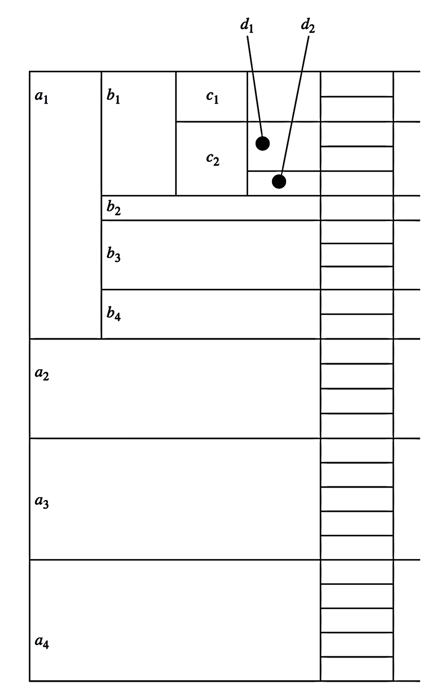
BUC: Partitioning and Aggregating
Usually, entire data set cannot fit in main memory
Sort distinct values
partition into blocks that fit
Continue processing
Optimizations
Partitioning
External Sorting, Hashing, Counting Sort
Ordering dimensions to encourage pruning
Cardinality, Skew, Correlation
Collapsing duplicates
Cannot do holistic aggregates anymore!

Slide 22
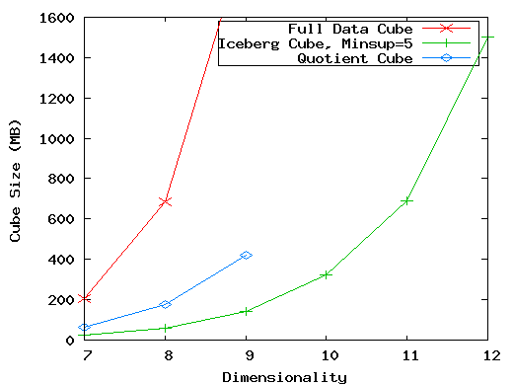
High-Dimensional OLAP?—The Curse of Dimensionality
High-D OLAP: Needed in many applications
Science and engineering analysis
Bio-data analysis: thousands of genes
Statistical surveys: hundreds of variables
None of the previous cubing method can handle high dimensionality!
Iceberg cube and compressed cubes: only delay the inevitable explosion
Full materialization: still significant overhead in accessing results on disk
A shell-fragment approach: X. Li, J. Han, and H. Gonzalez, High-Dimensional OLAP: A Minimal Cubing Approach, VLDB'04
A curse of dimensionality: A database of 600k tuples. Each dimension has cardinality of 100 and zipf of 2.

Slide 23
Fast High-D OLAP with Minimal Cubing
Observation: OLAP occurs only on a small subset of dimensions at a time
Semi-Online Computational Model
Partition the set of dimensions into shell fragments
Compute data cubes for each shell fragment while retaining inverted indices or value-list indices
Given the pre-computed fragment cubes, dynamically compute cube cells of the high-dimensional data cube online
Major idea: Tradeoff between the amount of pre-computation and the speed of online computation
Reducing computing high-dimensional cube into precomputing a set of lower dimensional cubes
Online re-construction of original high-dimensional space
Lossless reduction

Slide 24
Computing a 5-D Cube with 2-Shell Fragments
Example: Let the cube aggregation function be count
Divide the 5-D table into 2 shell fragments:
(A, B, C) and (D, E)
Build traditional invert index or TID list (1-D)
Attribute Value | TID List | List Size
a1 | 1 2 3 | 3
a2 | 4 5 | 2
b1 | 1 4 5 | 3
b2 | 2 3 | 2
c1 | 1 2 3 4 5 | 5
d1 | 1 3 4 5 | 4
d2 | 2 | 1
e1 | 1 2 | 2
e2 | 3 4 | 2
e3 | 5 | 1
TID | A | B | C | D | E
1 | a1 | b1 | c1 | d1 | e1
2 | a1 | b2 | c1 | d2 | e1
3 | a1 | b2 | c1 | d1 | e2
4 | a2 | b1 | c1 | d1 | e2
5 | a2 | b1 | c1 | d1 | e3
Notes:
Xinyang:
We should probably explain what is TID here. It’s a bit confusion when I was reading the book.
Highlight a2 as an example
Emphasize initial inv-idx table is 1-D

Slide 25
Shell Fragment Cubes: Ideas
Generalize the 1-D inverted indices to multi-dimensional ones in the data cube sense
Compute all cuboids for data cubes ABC and DE while retaining the inverted indices
Ex. shell fragment cube ABC contains 7 cuboids:
A, B, C; AB, AC, BC; ABC
This completes the offline computation
Attribute Value | TID List | List Size
a1 | 1 2 3 | 3
a2 | 4 5 | 2
b1 | 1 4 5 | 3
b2 | 2 3 | 2
c1 | 1 2 3 4 5 | 5
d1 | 1 3 4 5 | 4
d2 | 2 | 1
e1 | 1 2 | 2
e2 | 3 4 | 2
e3 | 5 | 1
Shell-fragment AB
ID_Measure Table
If measures other than count are present, store in ID_measure table separate from the shell fragments
tid | count | sum
1 | 5 | 70
2 | 3 | 10
3 | 8 | 20
4 | 5 | 40
5 | 2 | 30
Cell | Intersection | TID List | List Size
a1 b1 | 1 2 3 ∩ 1 4 5 | 1 | 1
a1 b2 | 1 2 3 ∩ 2 3 | 2 3 | 2
a2 b1 | 4 5 ∩ 1 4 5 | 4 5 | 2
a2 b2 | 4 5 ∩ 2 3 | φ | 0
Notes:
Xinyang:
Highlight cell a1b1 as an example

Slide 26
Shell Fragment Cubes: Size and Design
Given a database of T tuples, D dimensions, and F shell fragment size, the fragment cubes’ space requirement is:
For F < 5, the growth is sub-linear
Shell fragments do not have to be disjoint
Fragment groupings can be arbitrary to allow for maximum online performance
Known common combinations (e.g.,<city, state>) should be grouped together
Shell fragment sizes can be adjusted for optimal balance between offline and online computation
Attribute Value | TID List | List Size
a1 | 1 2 3 | 3
a2 | 4 5 | 2
b1 | 1 4 5 | 3
b2 | 2 3 | 2
c1 | 1 2 3 4 5 | 5
d1 | 1 3 4 5 | 4
d2 | 2 | 1
e1 | 1 2 | 2
e2 | 3 4 | 2
e3 | 5 | 1
Cell | Intersection | TID List | List Size
a1 b1 | 1 2 3 ∩ 1 4 5 | 1 | 1
a1 b2 | 1 2 3 ∩ 2 3 | 2 3 | 2
a2 b1 | 4 5 ∩ 1 4 5 | 4 5 | 2
a2 b2 | 4 5 ∩ 2 3 | φ | 0

Slide 27
Use Frag-Shells for Online OLAP Query Computation
Dimensions
A | B | C | D | E | F | …
A | B | C | D | E | F | G | H | I | J | K | L | M | N | …
ABC Cube
DEF Cube
D Cuboid
EF Cuboid
Instantiated
Base Table
Online
Cube
DE Cuboid
Cell | Tuple-ID List
d1 e1 | {1, 3, 8, 9}
d1 e2 | {2, 4, 6, 7}
d2 e1 | {5, 10}
… | …
Processing query in the form: <a₁, a₂, …, a_{n}: M>

Slide 28
Online Query Computation with Shell-Fragments
A query has the general form: <a₁, a₂, …, a_{n}: M>
Each a_{i} has 3 possible values (e.g., <3, ?, ?, *, 1: count> returns a 2-D data cube)
Instantiated value
Aggregate * function
Inquire ? Function
Method: Given the materialized fragment cubes, process a query as follows
Divide the query into fragments, same as the shell-fragment
Fetch the corresponding TID list for each fragment from the fragment cube
Intersect the TID lists from each fragment to construct instantiated base table
Compute the data cube using the base table with any cubing algorithm

Slide 29
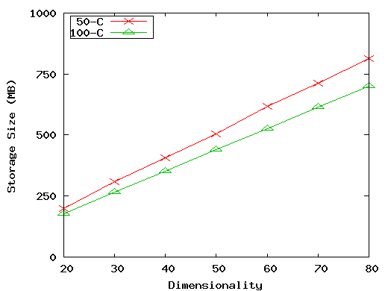
Experiment: Size vs. Dimensionality (50 and 100 cardinality)
Experiments on real-world data
UCI Forest CoverType data set
54 dimensions, 581K tuples
Shell fragments of size 2 took 33 seconds and 325MB to compute
3-D subquery with 1 instantiate D: 85ms~1.4 sec.
Longitudinal Study of Vocational Rehab.
Data: 24 dimensions, 8818 tuples
Shell fragments of size 3 took 0.9 seconds and 60MB to compute
5-D query with 0 instantiated D: 227ms~2.6 sec.
Limited size of materialized shell fragments
(50-C): 10⁶ tuples, 0 skew, 50 cardinality, fragment size 3
(100-C): 10⁶ tuples, 2 skew, 100 cardinality, fragment size 2

Slide 30
Chapter 5: Data Cube Technology
Data Cube Computation: Basic Concepts
Data Cube Computation Methods
Multidimensional Data Analysis in Cube Space
Summary
Notes:
30

Slide 31
Data Mining in Cube Space
Data cube greatly increases the analysis bandwidth
Four ways to interact OLAP-styled analysis and data mining
Using cube space to define data space for mining
Using OLAP queries to generate features and targets for mining, e.g., multi-feature cube
Using data-mining models as building blocks in a multi-step mining process, e.g., prediction cube
Using data-cube computation techniques to speed up repeated model construction
Cube-space data mining may require building a model for each candidate data space
Sharing computation across model-construction for different candidates may lead to efficient mining

Slide 32
Complex Aggregation at Multiple Granularities: Multi-Feature Cubes
Multi-feature cubes (Ross, et al. 1998): Compute complex queries involving multiple dependent aggregates at multiple granularities
Ex. Grouping by all subsets of {item, region, month}, find the maximum price in 2010 for each group, and the total sales among all maximum price tuples
select item, region, month, max(price), sum(R.sales)
from purchases
where year = 2010
cube by item, region, month: R
such that R.price = max(price)
Continuing the last example, among the max price tuples, find the min and max shelf live, and find the fraction of the total sales due to tuple that have min shelf life within the set of all max price tuples
Notes:
32

Slide 33
Discovery-Driven Exploration of Data Cubes
Discovery-driven exploration of huge cube space (Sarawagi, et al.’98)
Effective navigation of large OLAP data cubes
pre-compute measures indicating exceptions, guide user in the data analysis, at all levels of aggregation
Exception: significantly different from the value anticipated, based on a statistical model
Visual cues such as background color are used to reflect the degree of exception of each cell
Kinds of exceptions
SelfExp: surprise of cell relative to other cells at same level of aggregation
InExp: surprise beneath the cell
PathExp: surprise beneath cell for each drill-down path
Computation of exception indicator can be overlapped with cube construction
Exceptions can be stored, indexed and retrieved like precomputed aggregates
Notes:
33

Slide 34
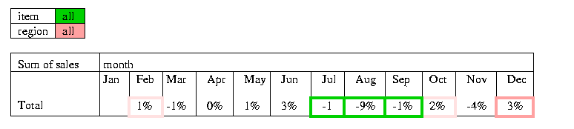
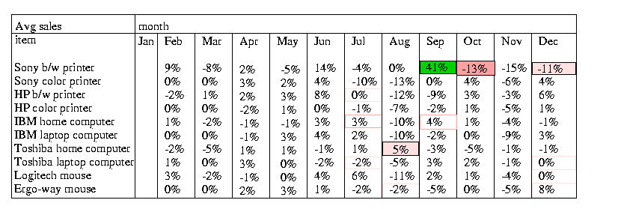
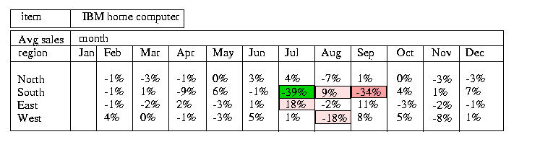
Examples: Discovery-Driven Data Cubes
34
Notes:
34

Slide 35
Chapter 5: Data Cube Technology
Data Cube Computation: Basic Concepts
Data Cube Computation Methods
Multidimensional Data Analysis in Cube Space
Summary
Notes:
35

Slide 36
Data Cube Technology: Summary
Data Cube Computation: Preliminary Concepts
Data Cube Computation Methods
MultiWay Array Aggregation
BUC
High-Dimensional OLAP with Shell-Fragments
Multidimensional Data Analysis in Cube Space
Multi-feature Cubes
Discovery-Driven Exploration of Data Cubes

Slide 37
Data Cube Technology: References (I)
S. Agarwal, R. Agrawal, P. M. Deshpande, A. Gupta, J. F. Naughton, R. Ramakrishnan, and S. Sarawagi. On the computation of multidimensional aggregates. VLDB’96
K. Beyer and R. Ramakrishnan. Bottom-Up Computation of Sparse and Iceberg CUBEs.. SIGMOD’99
J. Han, J. Pei, G. Dong, K. Wang. Efficient Computation of Iceberg Cubes With Complex Measures. SIGMOD’01
L. V. S. Lakshmanan, J. Pei, and J. Han, Quotient Cube: How to Summarize the Semantics of a Data Cube, VLDB'02
X. Li, J. Han, and H. Gonzalez, High-Dimensional OLAP: A Minimal Cubing Approach, VLDB'04
X. Li, J. Han, Z. Yin, J.-G. Lee, Y. Sun, “Sampling Cube: A Framework for Statistical OLAP over Sampling Data”, SIGMOD’08
K. Ross and D. Srivastava. Fast computation of sparse datacubes. VLDB’97
D. Xin, J. Han, X. Li, B. W. Wah, Star-Cubing: Computing Iceberg Cubes by Top-Down and Bottom-Up Integration, VLDB'03
Y. Zhao, P. M. Deshpande, and J. F. Naughton. An array-based algorithm for simultaneous multidimensional aggregates. SIGMOD’97
D. Burdick, P. Deshpande, T. S. Jayram, R. Ramakrishnan, and S. Vaithyanathan. OLAP over uncertain and imprecise data. VLDB’05

Slide 38
Data Cube Technology: References (II)
R. Agrawal, A. Gupta, and S. Sarawagi. Modeling multidimensional databases. ICDE’97
B.-C. Chen, L. Chen, Y. Lin, and R. Ramakrishnan. Prediction cubes. VLDB’05
B.-C. Chen, R. Ramakrishnan, J.W. Shavlik, and P. Tamma. Bellwether analysis: Predicting global aggregates from local regions. VLDB’06
Y. Chen, G. Dong, J. Han, B. W. Wah, and J. Wang, Multi-Dimensional Regression Analysis of Time-Series Data Streams, VLDB'02
R. Fagin, R. V. Guha, R. Kumar, J. Novak, D. Sivakumar, and A. Tomkins. Multi-structural databases. PODS’05
J. Han. Towards on-line analytical mining in large databases. SIGMOD Record, 27:97–107, 1998
T. Imielinski, L. Khachiyan, and A. Abdulghani. Cubegrades: Generalizing association rules. Data Mining & Knowledge Discovery, 6:219–258, 2002.
R. Ramakrishnan and B.-C. Chen. Exploratory mining in cube space. Data Mining and Knowledge Discovery, 15:29–54, 2007.
K. A. Ross, D. Srivastava, and D. Chatziantoniou. Complex aggregation at multiple granularities. EDBT'98
S. Sarawagi, R. Agrawal, and N. Megiddo. Discovery-driven exploration of OLAP data cubes. EDBT'98
G. Sathe and S. Sarawagi. Intelligent Rollups in Multidimensional OLAP Data. VLDB'01

